Slide 1
Home Rental App
Using MERN STACK
TEAM- ITB20
S.Vikram (au211521205186)
V.S.Vezhavendhan (au211521205180)
N.InbhaKumar (au211521205302)
S.Bharanichandar (au211521205301)

Slide 2
ABSTRACT
The House Rent App is designed to streamline the process of renting houses by leveraging the MERN stack (MongoDB, Express.js, React.js, Node.js). This application aims to provide a comprehensive, user-friendly platform for both landlords and tenants.
Technologies Used:
MongoDB: For storing user and property data.
Express.js: To handle server-side logic.
React.js: For building dynamic user interfaces.
Node.js: As the runtime environment for executing server-side code.

Slide 3
INTRODUCTION
Key Objectives:
The house rental market faces several challenges, including the difficulty of finding suitable rental properties, lack of a centralized platform, and inefficiencies in the rental process. Traditional methods often involve time-consuming searches, unreliable listings, and cumbersome communication between landlords and tenants.
The House Rent App aims to address these challenges by providing a digital solution that simplifies and enhances the rental process. By leveraging the MERN stack (MongoDB, Express.js, React.js, Node.js), the app offers a comprehensive platform that caters to the needs of both landlords and tenants
Simplify the Rental Process
Centralized Platform
Enhanced User Experience

Slide 4
PROPOSED SYSTEM
System Architecture: The House Rent App uses the MERN stack
MongoDB: Stores user info, property listings, bookings, and reviews.
Express.js: Manages server-side logic and routes.
React.js: Builds dynamic user interfaces.
Node.js: Executes server-side code.
Features:
User Authentication: Secure registration and login, role-based access.
Property Listings: Detailed descriptions with images, location, and amenities.
Search and Filter: Advanced search options based on various criteria.
Booking and Payment: Direct booking and secure payment integration.
Reviews and Ratings: Users can leave and respond to reviews.

Slide 5
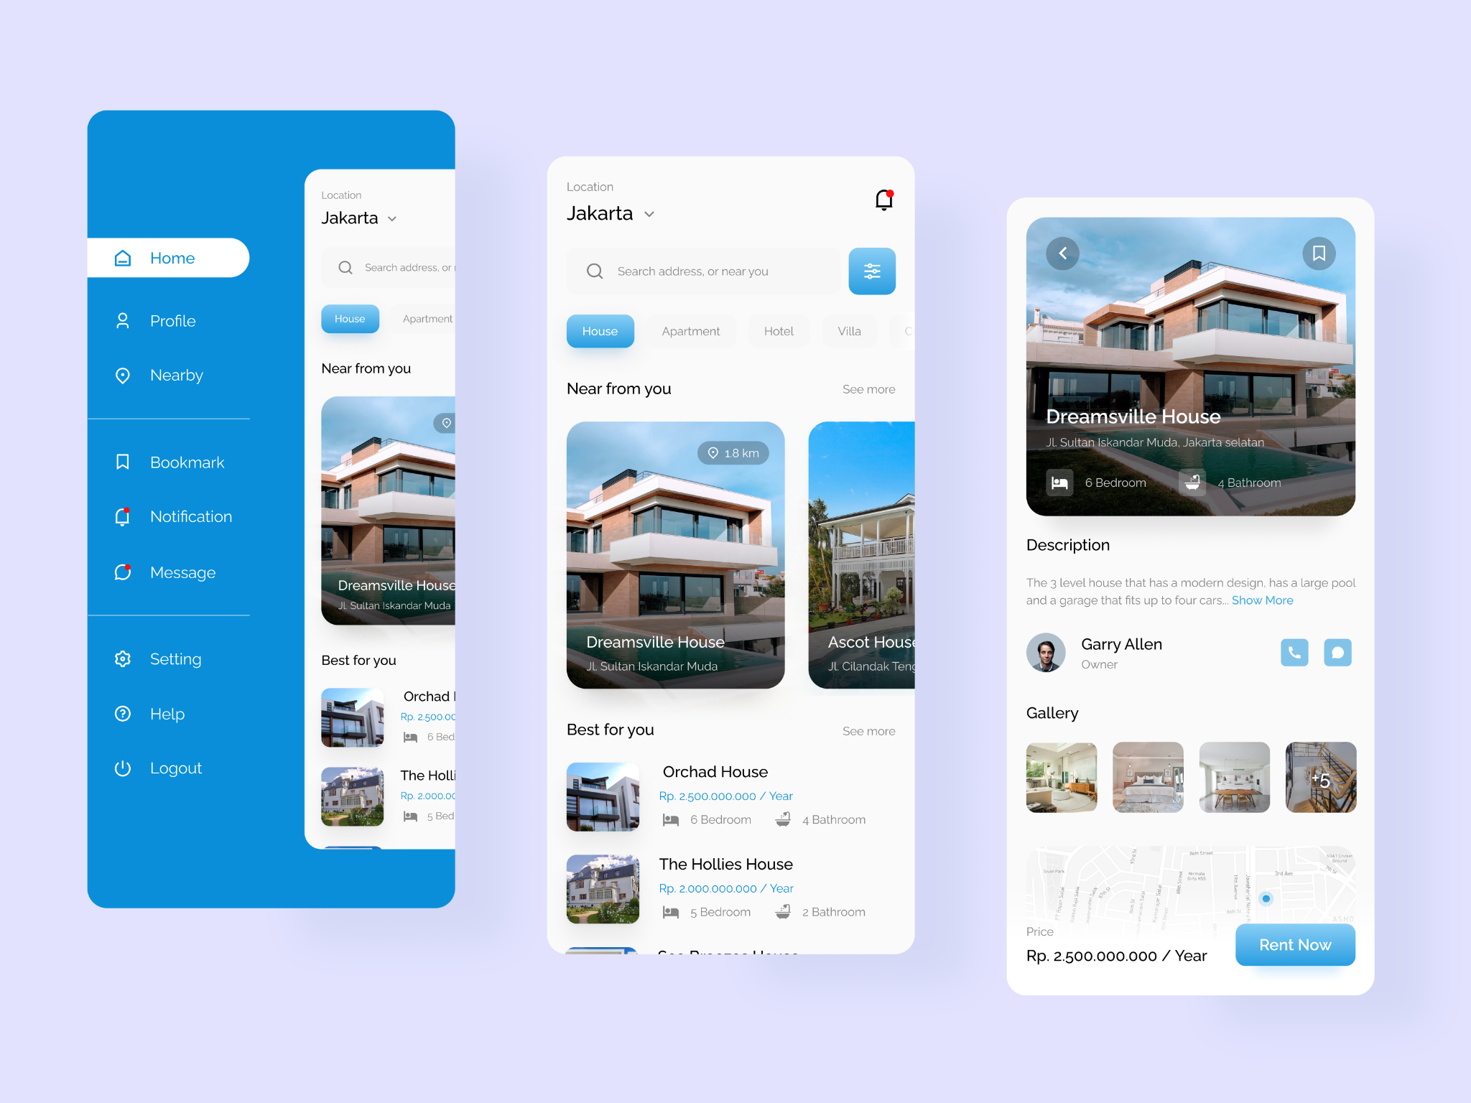
SCREENSHOT OF THE MODEL

Slide 6
CONCLUSION
The House Rent App, built using the MERN stack, offers a comprehensive solution to streamline the house rental process. By integrating MongoDB, Express.js, React.js, and Node.js, the app provides a robust and scalable platform that addresses the challenges faced by both landlords and tenants.
Key Benefits:
Enhanced User Experience: The app simplifies the process of finding and renting houses, making it more efficient and user-friendly.
Centralized Platform: It offers a single platform for managing property listings, bookings, and payments.
Secure and Reliable: With features like user authentication and secure payment integration, the app ensures a safe and trustworthy environment for transactions.
Future Work:
Potential Enhancements: Adding more features such as virtual tours, chat support, and AI-based recommendations.
Scalability: Ensuring the app can handle increasing user loads and expanding to new markets.
Overall, the House Rent App aims to revolutionize the house rental market by providing a seamless and efficient digital solution, benefiting all parties involved.

Slide 7
THANK YOU!!!
Thank you for your attention and participation in this presentation on the House Rent App using the MERN stack. I hope you found the information insightful and valuable. If you have any questions or need further clarification, please feel free to ask. Your feedback and suggestions are always welcome.

